Slide 1

E-news Express project 2
Business statistics
Presenter: Joshua Willis, PGP-DSBA

Slide 2
Background
E-news plans to expand its business by acquiring new subscribers. Every visitor to the website takes certain actions based on their interest. The company plans to analyze these interests and wants to determine whether a new feature will be effective or not.
Companies often analyze users' responses to two variants of a product to decide which of the two variants is more effective. This experimental technique is known as a/b testing that is used to determine whether a new feature attracts users based on a chosen metric.
An assessment needs to be made to determine if the company’s new landing page is gathering more subscribers.
100 users have been randomly selected and divided into two groups. The old landing page is the first group (control group) and the new landing page is assigned to the second group (treatment group).
Various data has been collected about the customers in both groups.
The company aims to expand its business by acquiring new subscribers.

Slide 3





Objective:
To conduct a statistical analysis of business data collected from users
EDA
Old vs. New
Subscribers
Language
Conclusions & Recommendations
Explore the data sets and extract insights using EDA
(Exploratory Data Analysis)
Assess whether users spend more time on the new landing vs the old page.
Is the proportion of users who visit the new landing page and become subscribers greater than those for the old page?
Does whether a user subscribe or not depend on the language preferred? Is the mean time spent on new page the same for different language users?
Based on the analysis, what are the next steps?

Slide 4
Objective one:
Exploratory Data analysis

Slide 5
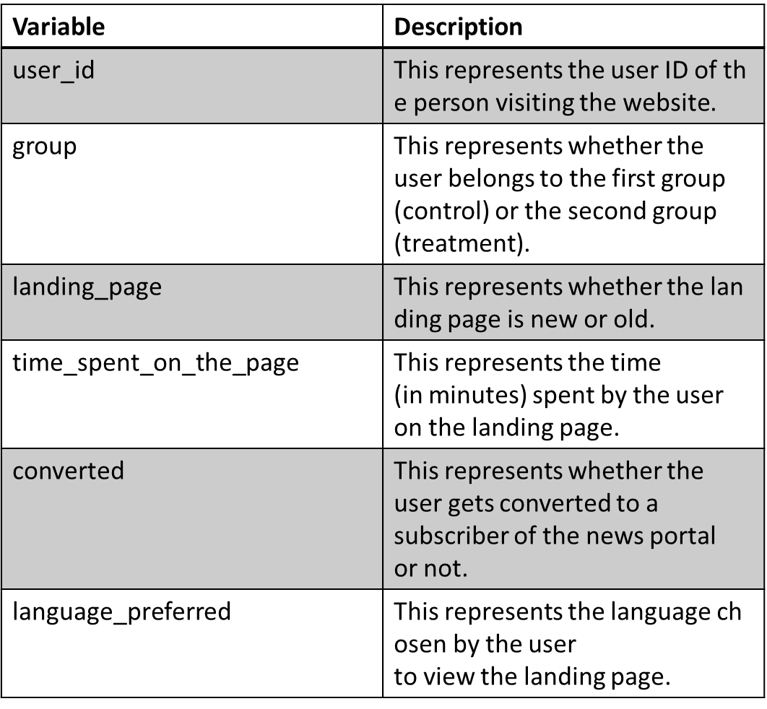
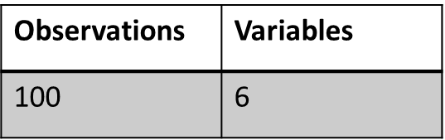
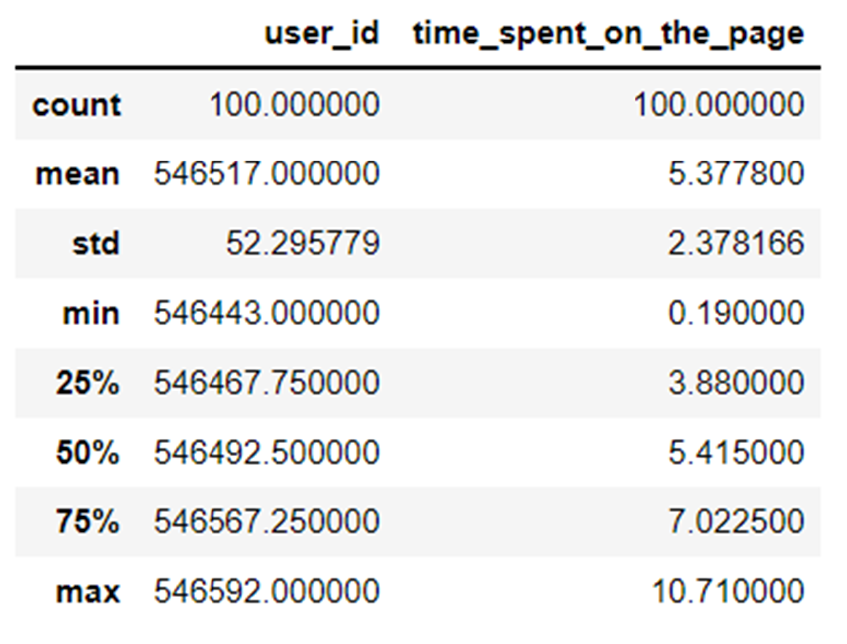
Exploratory Data Analysis
Data Dictionary
Observations:
No missing or null values
All category variables except for user id and time spent on the page which are integers
There are 100 unique users
Statistical summary for time spent on page is based on old and new landing page

Slide 6
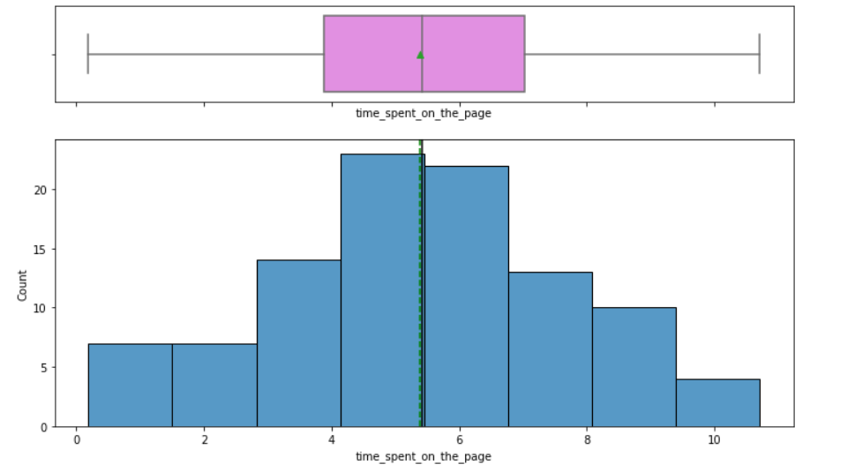
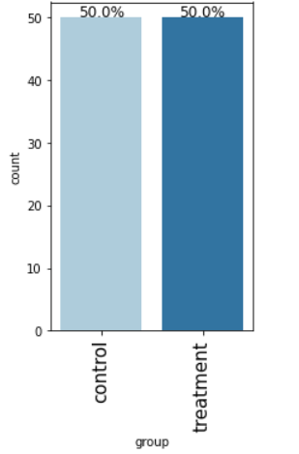
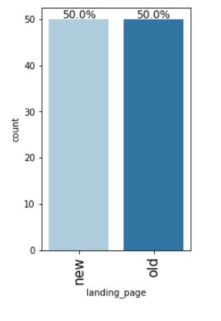
Univariate Analysis
Observations:
Time spent between both old and new page was 5.37
Time spent on both pages appear to be a normal distribution
The are 2 unique groups: control and treatment. Each group consists of 50 users.
There are 2 landing pages – new and old

Slide 7
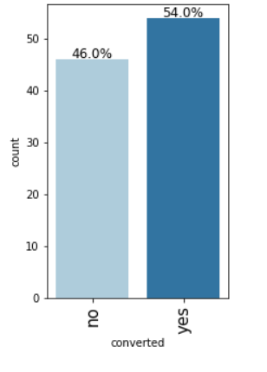
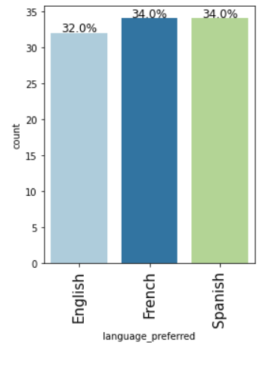
Univariate Analysis
Observations:
Overall, 54 users were converted, and 46 users were not converted after visiting the landing page
There are 3 unique preferred languages: English, French, and Spanish

Slide 8
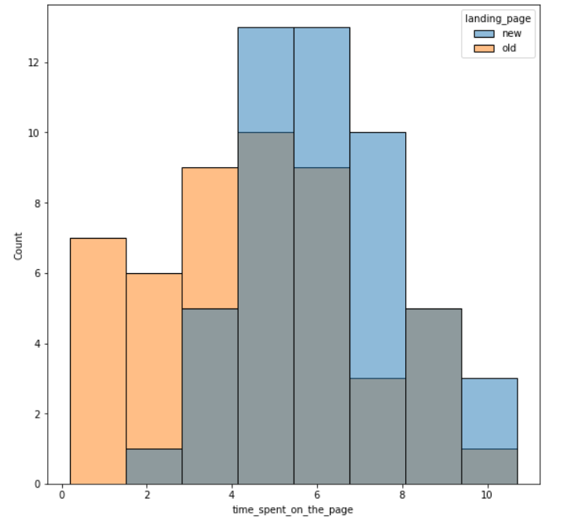
Bivariate Analysis
Observations:
Visually, it appears as users spend less time on the old page vs the new page

Slide 9
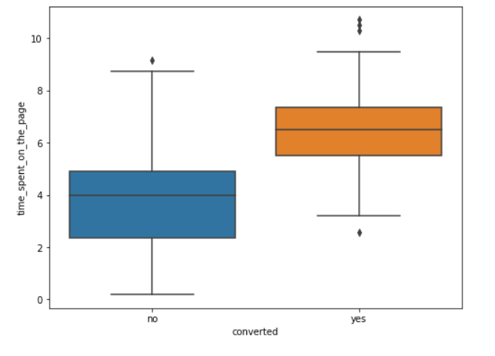
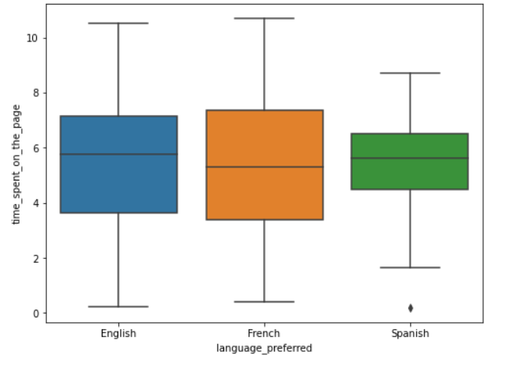
Bivariate Analysis
Observations:
Visually it appears users who converted to subscribers spent more time either on the old or new landing page
Visually it appears the language preferred is English & French

Slide 10
Objective two:
Assess whether users spend more time on the new landing vs the old page.

Slide 11
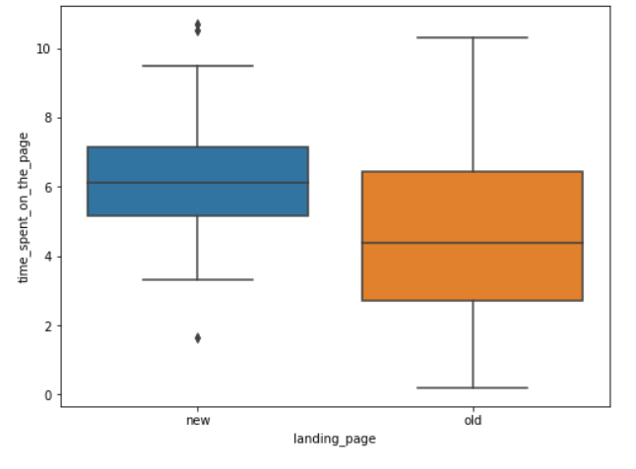
Statistical Analysis
Observations:
Visually it appears users spend more time on the new page than the old page, but we need to prove it with statistical analysis
We set the null and alternative hypothesis accordingly
Since this is a one-tailed test concerning two population means from two independent populations and the standard deviation is unknown we use:
    Two Independent sample t-test
Define the null and alternative hypothesis:
𝐻0 = The mean time spent on old landing page is equal to the mean time spent on the new landing page.
𝐻𝑎 = The mean time spent on new landing page is greater than the mean time spent on old landing page.
Let 𝜇1 and 𝜇2 be the mean time spent on page for the old and new landing page respectively.
Mathematically, the above formulated hypotheses can be written as:
𝐻0:𝜇1=𝜇2
𝐻𝑎:𝜇1<𝜇2

Slide 12
Statistical Analysis
(cont.)
Inference:
At the 5% significance level, we fail to reject the null hypothesis. Hence, we have enough statistical evidence to say that the mean time spent on the new landing page is more than the old landing page.
Decide the significance level:
It has been determined that α = 0.05
Based upon collection & preparation of data:
The sample standard deviation of the time spent on the new page is: 1.82
The sample standard deviation of the time spent on the old page is: 2.58
Based on the sample standard deviations of the two groups, the population standard deviations can be assumed to be unequal.
Calculate the p-value with α :
We use the ttest_ind function
The p-value is 0.0001392381225166549
Compare the p-value with α :
As the p-value 0.0001392381225166549 is less than the level of significance, we reject the null hypothesis.

Slide 13
Objective three:
Is the conversion rate (the proportion of users who visit the landing page and get converted) for the new page greater than the conversion rate for the old page?

Slide 14
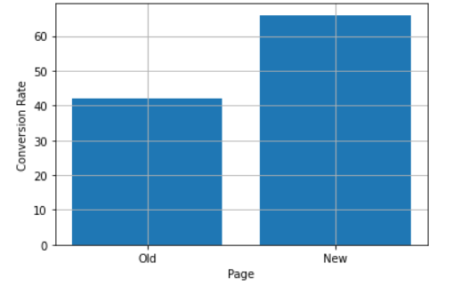
Statistical Analysis
Observations:
Visually it appears the conversion rate is higher for the new page vs. the old page
We set the null and alternative hypothesis accordingly
Since this is a one-tailed test concerning two population proportions from two independent populations we will use:
    Two sample z-test
Define the null and alternative hypothesis:
Let 𝑝1,𝑝2 be the proportions of the conversion rate for the old page and new page, respectively.
We will test the null hypothesis
𝐻0:𝑝1=𝑝2 (The proportions of the conversion rate is equal for both old and new landing pages)
against the alternate hypothesis
𝐻𝑎:𝑝1 < 𝑝2 (The proportions of the conversation rate is greater for the new landing page)

Slide 15
Statistical Analysis
(cont.)
Inference:
As the p-value is less than the significance level 0.05, we reject the null hypothesis. Thus, we do have enough statistical significance to conclude that the conversion rate for the new page is greater.
Decide the significance level:
It has been determined that α = 0.05
Based upon collection & preparation of data:
The numbers of users served the new and old pages are 50 and 50 respectively
The conversion rate for the old website is 42.0 %
The conversion rate for the new website is 66.0 %
Calculate the p-value with α :
We use the proportions_ztest function
The p-value is 0.008026308204056278
Compare the p-value with α :
As the p-value 0.008026308204056278 is less than the level of significance, we reject the null hypothesis.

Slide 16
Objective four:
Does the converted status depend on the preferred language?

Slide 17
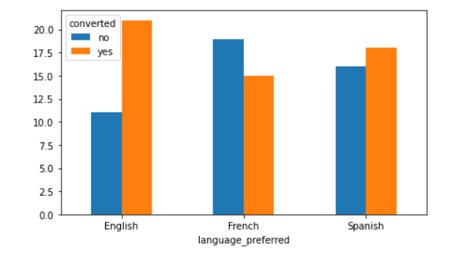
Statistical Analysis
Observations:
Visually it might appear that number of subscribers (converted) depends upon language preferred
We set the null and alternative hypothesis accordingly
Since this is a problem that tests independence, concerning two categorical variables – converted status and preferred language we will use:
    Chi Square Test of Independence
Define the null and alternative hypothesis:
We will test the null hypothesis
𝐻0: Converted status is independent of preferred language.
against the alternate hypothesis
𝐻𝑎: Converted status is dependent upon preferred language.

Slide 18
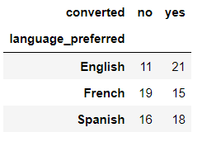
Statistical Analysis
(cont.)
Inference:
As the p-value is greater than the significance level, we fail to reject the null hypothesis. Hence, we do not have enough statistical significance to conclude that converted status is dependent upon preferred language.
Decide the significance level:
It has been determined that α = 0.05
Based upon collection & preparation of data:
We create a pivot table showing converted status indexed by language preferred
Calculate the p-value with α :
We use the chi2_contingency function
The p-value is 0.2129888748754345
Compare the p-value with α :
As the p-value 0.2129888748754345 is greater than the level of significance, we fail to reject the null hypothesis.

Slide 19
Objective five:
Is the mean time spent on the new page same for the different language users?

Slide 20
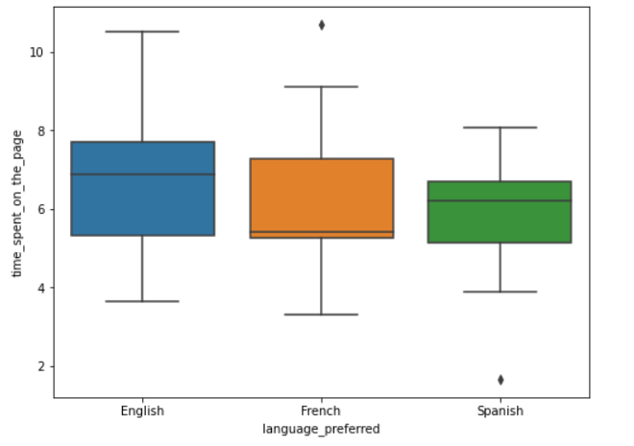
Statistical Analysis
Observations:
Visually it might appear that on the new page users become subscribers based upon language preferred
We set the null and alternative hypothesis accordingly
Since this is a problem concerning three population means we must check assumptions for normality and equality of variance for the three groups
    For testing of normality, Shapiro-Wilk’s test is applied to the response variable.
    For equality of variance, Levene test is applied to the response variable.
    Will be using one-way ANOVA Test
Define the null and alternate hypotheses:
Let 𝜇1,𝜇2,𝜇3 be the means of time spent on page for languages preferred English, French, and Spanish respectively.
We will test the null hypothesis
𝐻0:𝜇1=𝜇2=𝜇3
against the alternative hypothesis
𝐻𝑎: At least one mean time spent on page is different from the rest of the languages preferred
Then proceed with Shapiro-Wilk’s & Levene’s Test

Slide 21
Statistical Analysis
(cont.)
Observations:
For testing of normality, Shapiro-Wilk’s test is applied to the response variable
We set the null and alternative hypothesis accordingly
Define the null and alternative hypothesis:
Shapiro-Wilk’s Test
We will test the null hypothesis
𝐻0: Time spent on the new page follows a normal distribution
against the alternative hypothesis
𝐻𝑎: Time spent on the new page does not follow a normal distribution

Slide 22
Statistical Analysis
(cont.)
Shapiro-Wilk’s Test
Inference:
Since p-value of the test is fairly larger than the 5% significance level, we fail to reject the null hypothesis that the response follows the normal distribution.
Assumption 1:
Normality
Calculate the p-value with α :
We use the shapiro function
The p-value is 0.8040016293525696
Compare the p-value with α :
Since p-value of the test is very large than the 5% significance level, we fail to reject the null hypothesis that the response follows the normal distribution.

Slide 23
Statistical Analysis
(cont.)
Observations:
For equality of variance, Levene test is applied to the response variable.
We set the null and alternative hypothesis accordingly
Define the null and alternative hypothesis:
Levene’s Test
We will test the null hypothesis
𝐻0 : All the population variances are equal
against the alternative hypothesis
𝐻𝑎 : At least one variance is different from the rest

Slide 24
Statistical Analysis
(cont.)
Levene’s Test
Inference:
Since the p-value is large than the 5% significance level, we fail to reject the null hypothesis of homogeneity of variances.
Assumption 1:
Homogeneity of Variance
Calculate the p-value with α :
We use the levene function
The p-value is 0.46711357711340173
Compare the p-value with α :
Since the p-value is large than the 5% significance level, we fail to reject the null hypothesis of homogeneity of variances.

Slide 25
Statistical Analysis
(cont.)
One Way ANOVA
Inference:
As the p-value is greater than the significance level, we fail to reject the null hypothesis. Hence, we do not have enough statistical significance to conclude that at least one mean time spent on page is different from the rest of the languages preferred.
Decide the significance level:
It has been determined that α = 0.05
Based upon collection & preparation of data:
We filter data to find time spent on new page grouped by all three languages
Calculate the p-value with α :
We use the f_oneway function
The p-value is 0.43204138694325955
Compare the p-value with α :
As the p-value 0.43204138694325955 is greater than the level of significance, we fail to reject the null hypothesis.

Slide 26

Conclusions & Business Recommendations
How will we scale in the future
Conclusions
Recommendations
The average time spent on the new page is more than the old page
The new page is converting users to subscribers
The conversion status does not depend upon language preferred
The time spent on page is not much different amongst the language preferred
Implement study to understand what about the new page is causing users to spend more time on it
Identify what about the new page is converting users into subscribers and expand upon that
Survey users in both control and treatment groups to assess what they like about old and new pages
Survey subscribers to understand what converted them

